Slide 1
Paraphrasing

Slide 2
What is paraphrasing?
Paraphrasing is restating the meaning of a text or passage using your own words

Slide 3
Paraphrasing Rules

Slide 4
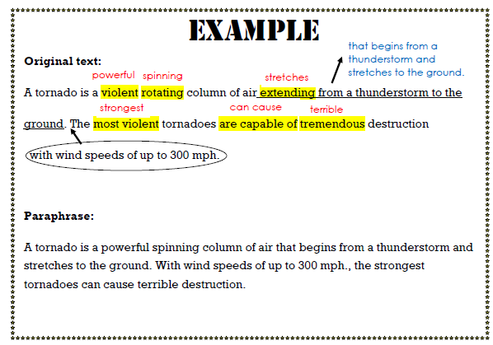
Paraphrasing Example

